Slide 1
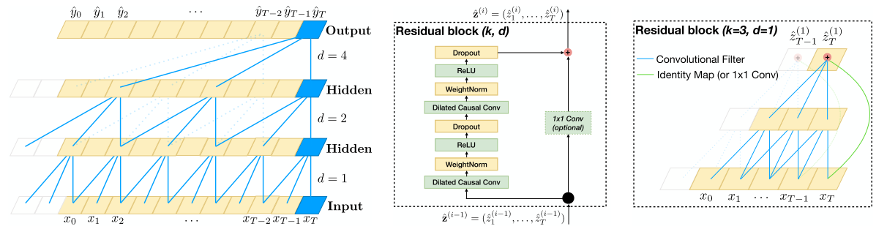
Temporal Convolutional Networks
2d Lt Mark A. Demore II

Slide 2
Overview
Background
Convolution
Causality
Dilation
Residuals
Advantages
Disadvantages
Implementation

Slide 3
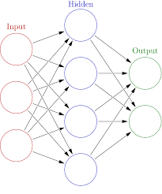
Background
Convolutional Neural Networks
Natural Language Processing
Recurrent Neural Networks
LSTM

Slide 4

Convolution
Digital Signals Processing
Computer Vision
Time Series Data

Slide 5
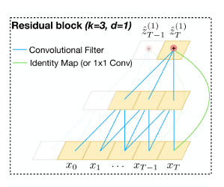
Causality
Input length = output length
No information leakage
TCN = 1D FCN + causal convolutions

Slide 6
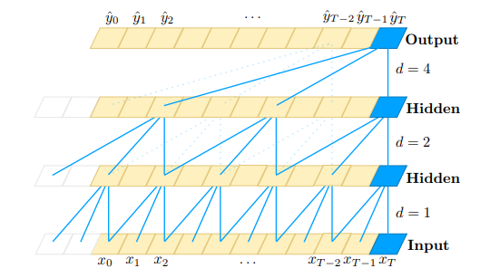
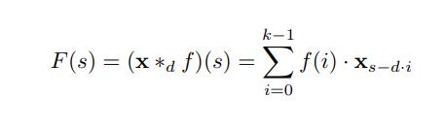
Dilation
Allow for a larger receptive field
Exponential vs linear growth with each layer
For a 1-D sequence input x ∈ R^n and a filter
f: {0,…,k-1} → R, the dilated convolution operation F on element s of the sequence is defined as:
where d is the dilation factor, k is the filter size, and s – d * i accounts for the direction of the past

Slide 7
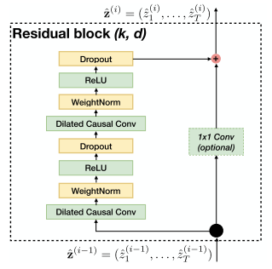
Residuals
Outputs added to inputs
Modifications rather than transformations
(Optional) Input passed through convolution

Slide 8
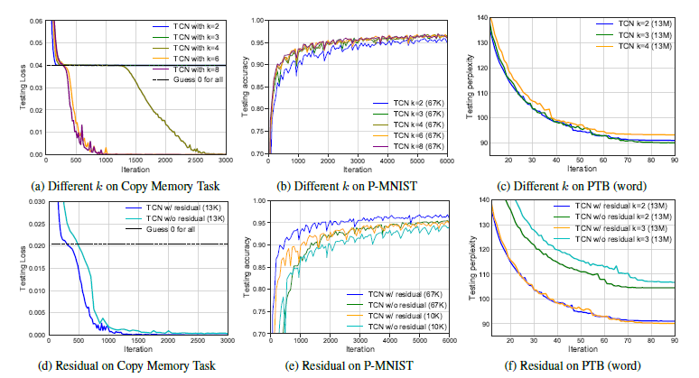
Advantages
Parallelism
Flexible receptive field
Low memory for training
Variable input length
Stable gradients

Slide 9
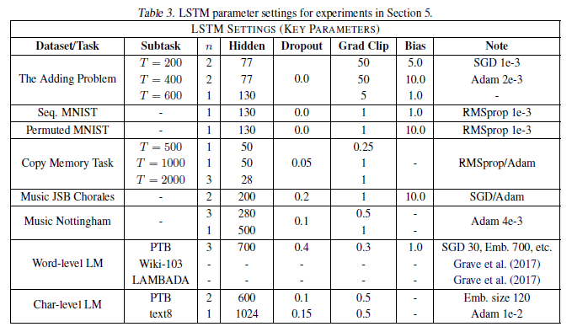
Disadvantages
Parameterization
More memory for testing

Slide 10
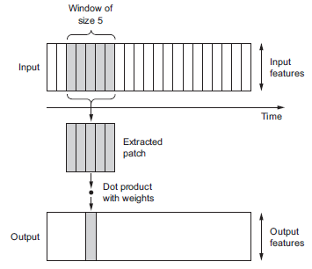
Implementation
See jupyter notebook

Slide 11
References
[1] Bai, Shaojie, J. Zico Kolter, and Vladlen Koltun. "An empirical evaluation of generic convolutional and recurrent networks for sequence modeling." arXiv preprint arXiv:1803.01271 (2018).
[2] Lee, Ceshine. “[Tensorflow] Implementing Temporal Convolutional Networks.” Medium, Veritable, 14 Mar. 2019, medium.com/the-artificial-impostor/notes-understanding-tensorflow-part-3-7f6633fcc7c7.
[3] Roy, Raushan. “TEMPORAL CONVOLUTIONAL NETWORKS.” Medium, Medium, 4 Feb. 2019, medium.com/@raushan2807/temporal-convolutional-networks-bfea16e6d7d2.
[4] Chollet François. Deep Learning with Python. Manning Publications Co., 2018.

Slide 12

Questions?

